Slide 1
Structural Health Monitoring of Wind Turbine Blades: Feature Extraction and Classification
Gabriel Freitas Santos
Fernanda Marinho Filizzola
HIML – DEM/PUC-Rio

Slide 2
Agenda
Problem description
Data-ingestion pipeline
Results
Concluding remarks
Future work

Slide 3
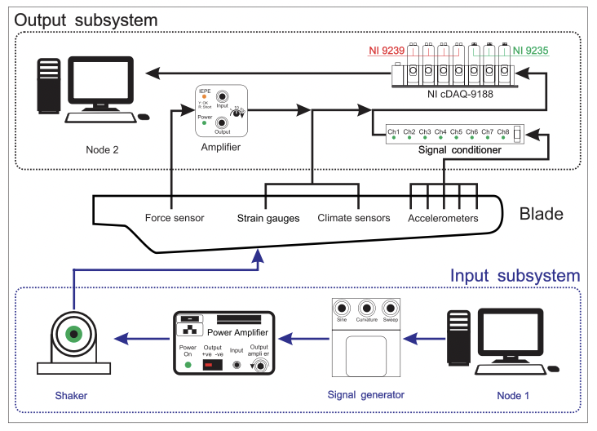
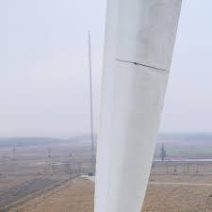
Problem description
Wind Turbine blade damage impacts both structural health and asset performance;
Dataset from experimental benchmark available in [Yaowen Ou et al., Struct Control Health Monit (28). 2021].

Slide 4
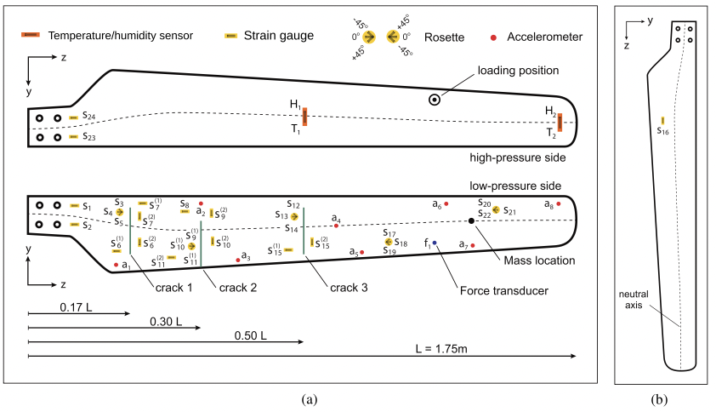
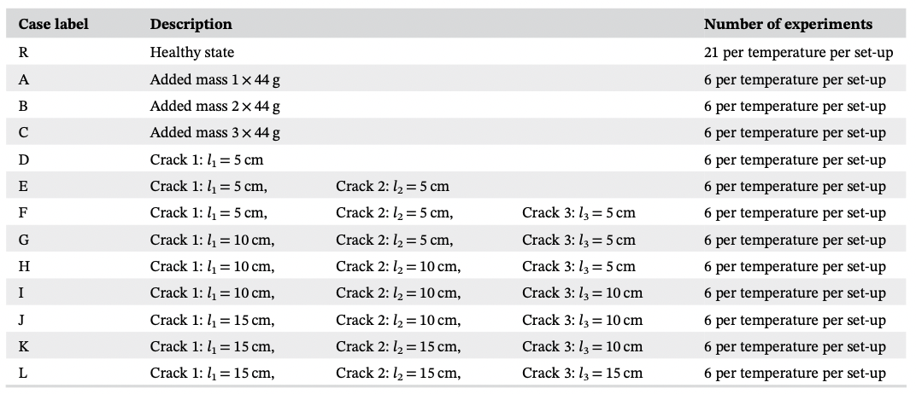
Problem description
Available 13 datasets (1 healthy + 12 faulty cases) for 6 temperature set-ups each;
This work considers measured data on 25°C from all eight accelerometers;

Slide 5
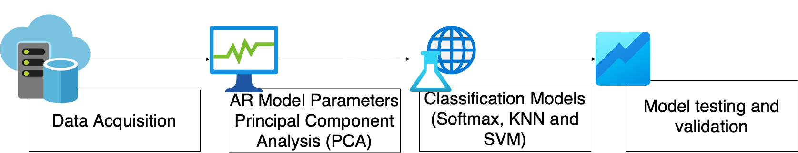
Data-ingestion pipeline

Slide 6
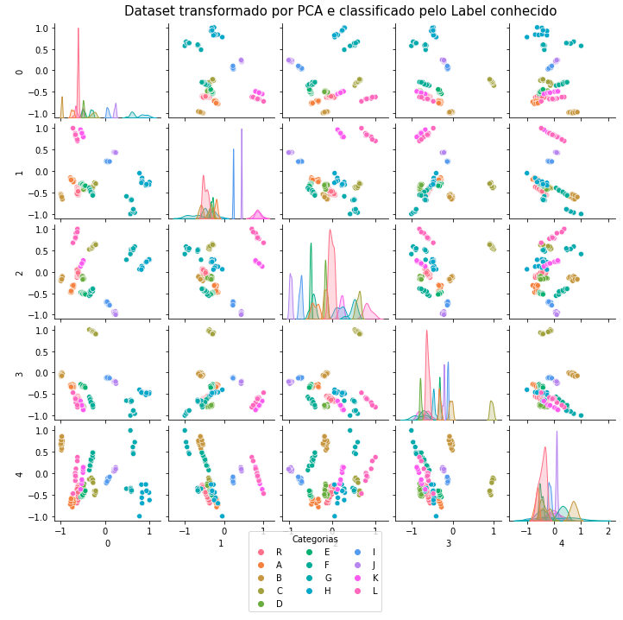
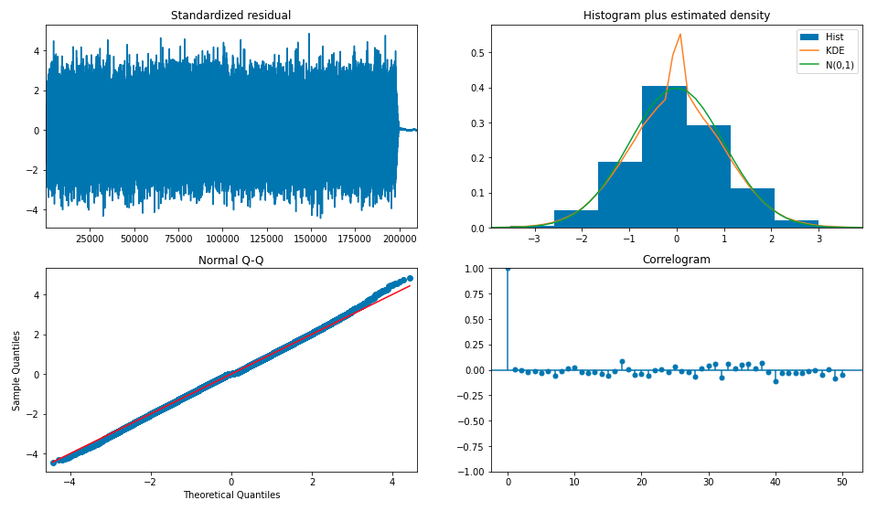
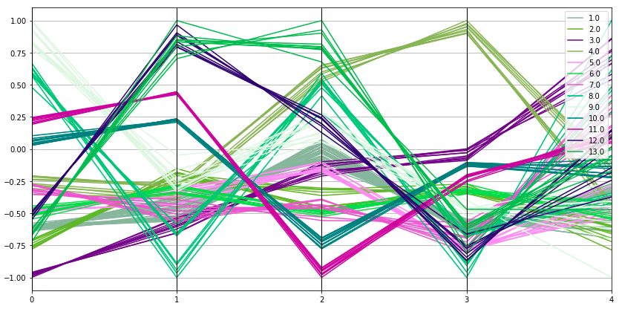
Results
Exploratory Analysis to define best lag for AR model (lag=17)
Dataset resultant from PCA transformation with AR parameters shows well defined clusters;
Feature Extraction of first five components from PCA could explain more then 90% of original features variance.

Slide 7
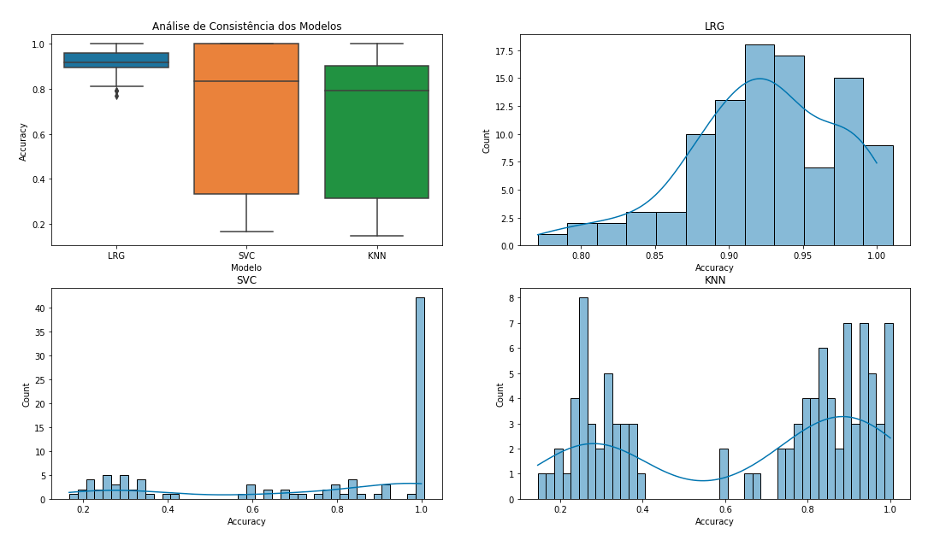
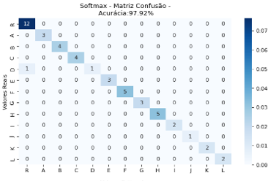
Results
Monte Carlo simulation with different seeds to guarantee model robustness;
Test protocol used cross-validation with repeated k-fold to define best parameters for each model;
PCA transformed dataset used as feature for 3 classification models (Softmax, KNN and SVM);

Slide 8
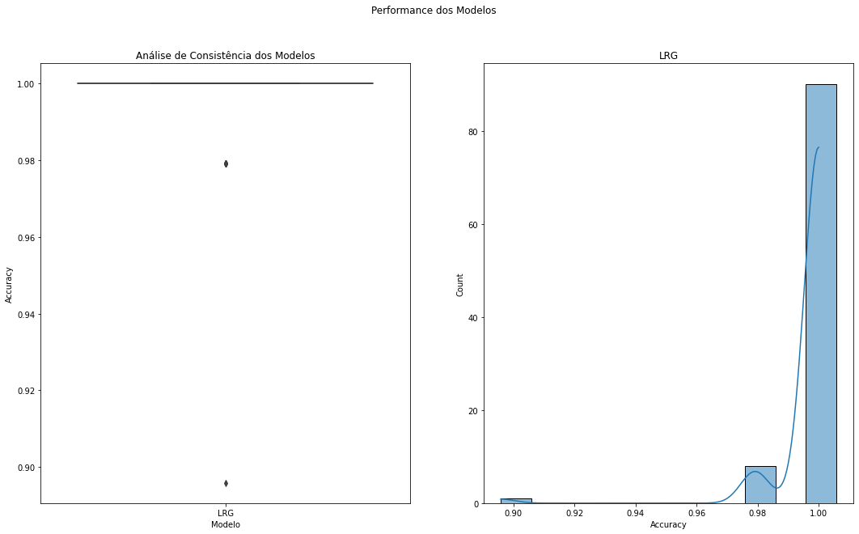
Concluding remarks
The LRG model was the strategy that demonstrated greater robustness due to a lower dependence on the training set as a result of a lower variance of the accuracy indicator of the test set.
Even with the use of a random search of parameters, it was verified that there was a high permanence of models whose best parameters were: C=~1; Solver = LBFGS; and Multi_class = Multinomial
Varying the C parameter between 0.1 and 1 we obtained more than 95% of the iterations with accuracy above 98%

Slide 9
Future work
Expand analysis to other test conditions mainly at other temperatures;
Include more variables available in the original dataset and test the impact on the PCA transformation seeking to reduce the number of components used

